Slide 1


SAP BTP CPI Training

Slide 2

DISCLAIMER
The training content and delivery of this presentation is confidential, and cannot be recorded, or copied and distributed to any third party, without the written consent of Anubhav Trainings

Slide 3


Introduction

Slide 4
Agenda
Idoc adapter
SFTP Adapter
Number Range
JMS Adapter
Ariba Adapter
Groovy script
Encoder and Decoder

Slide 5
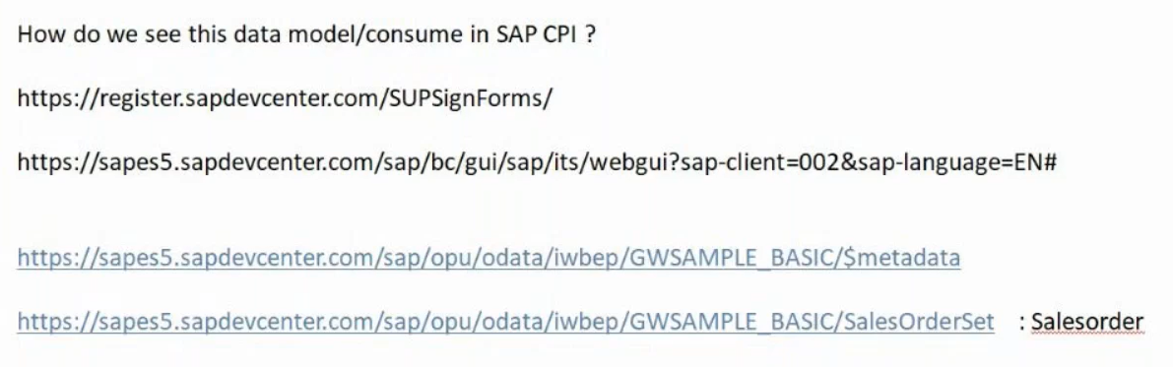
SAP DEMO SYSTEM

Slide 6
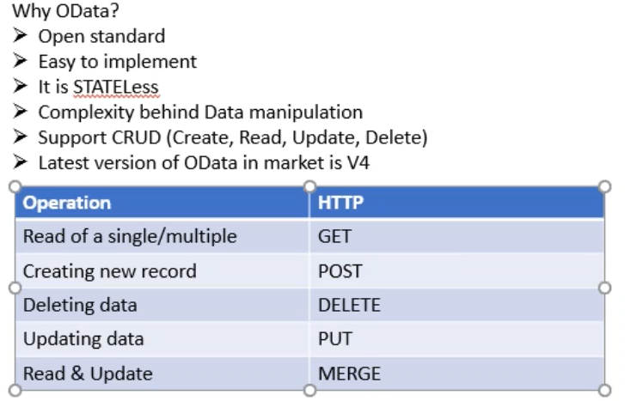
Odata

Slide 7
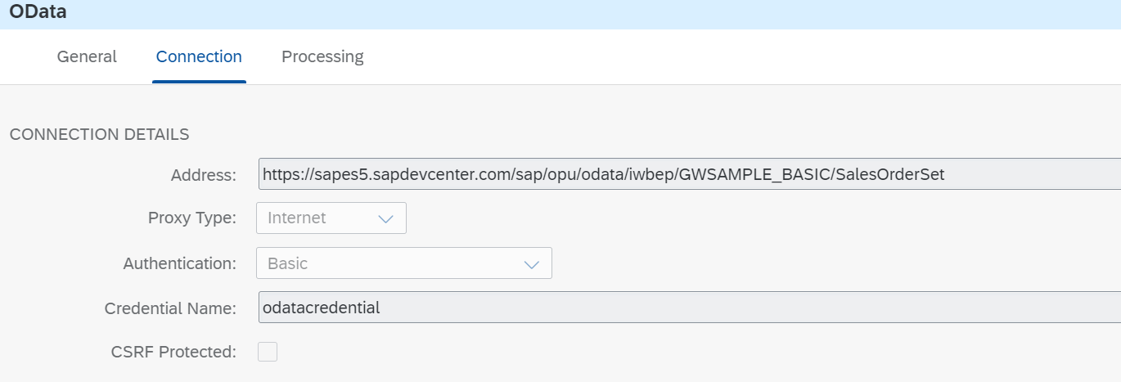

Slide 8
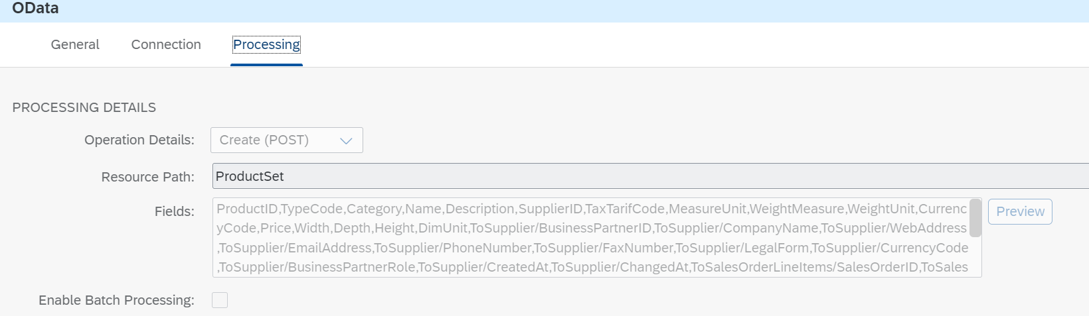

Slide 9
Number Range
SAP Cloud Integration offers Number Ranges to insert unique sequence numbers as part of the inbound or outbound messages.
A number sequence is created to help the trading partners to detect and avoid duplicate, missing or out of sequence interchange transmissions.

Slide 10
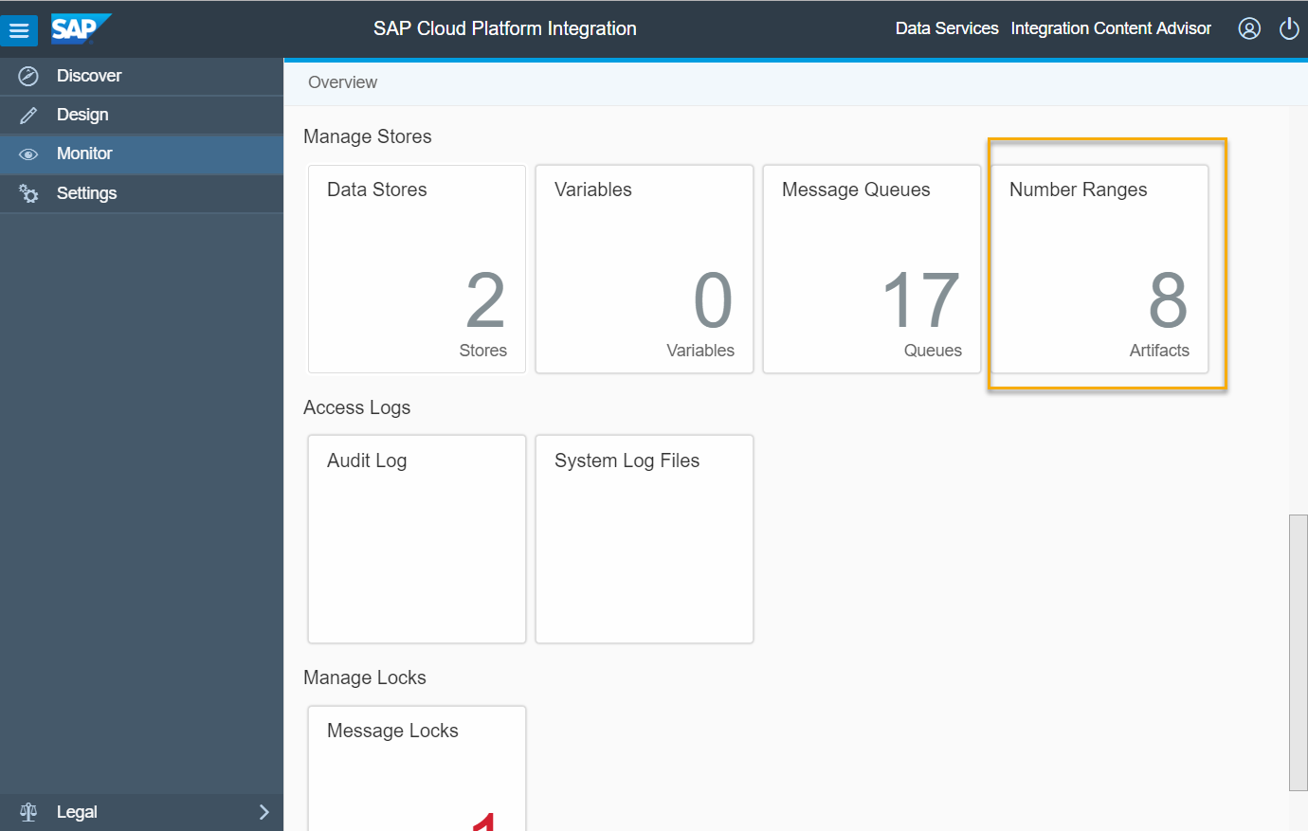
Number RAnge
To configure Number Ranges, navigate to Monitor->Manage Stores->Number Ranges as shown in the below screenshot
In real time, some receivers want to have messages in sequence and track if any message has got missed or failed during processing. With this counter in the header of the message will help the business in keeping track of the message flows.

Slide 11
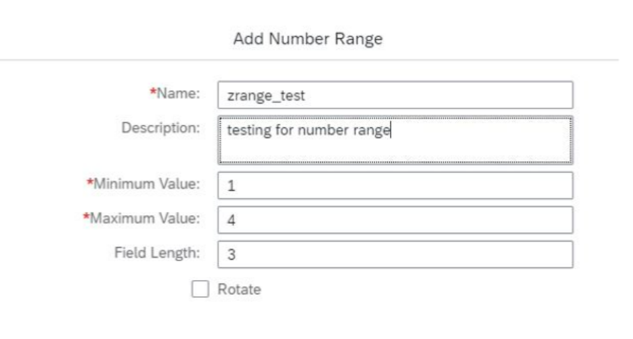
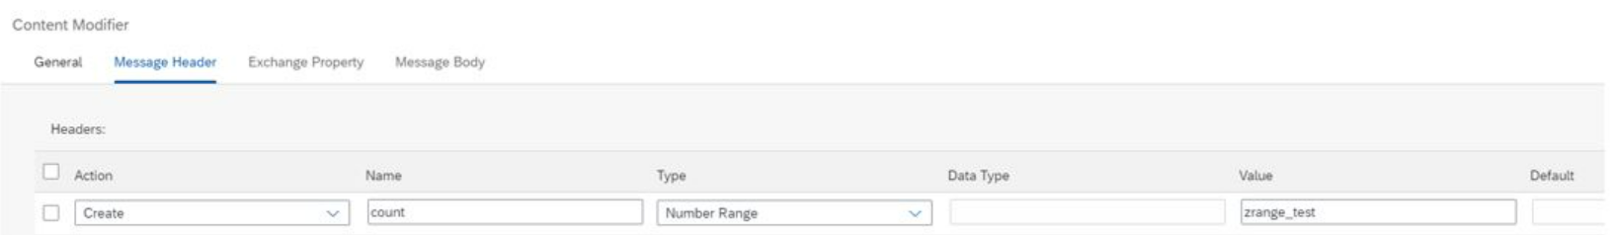
Number RAnge

Slide 12
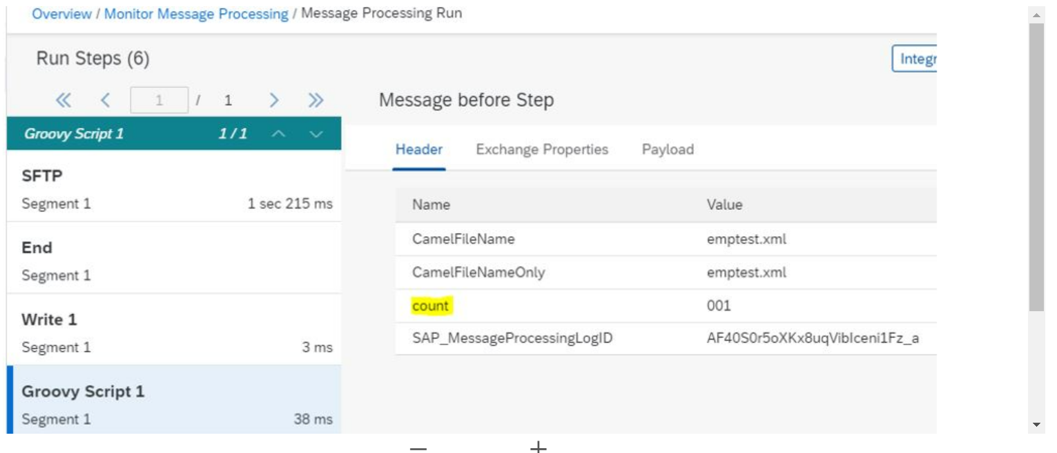
Number RAnge

Slide 13
Idoc Adapter
IDoc is an SAP object that carries data of a business transaction from one system to another in the form of electronic message. IDoc is an acronym for Intermediate Document

Slide 14
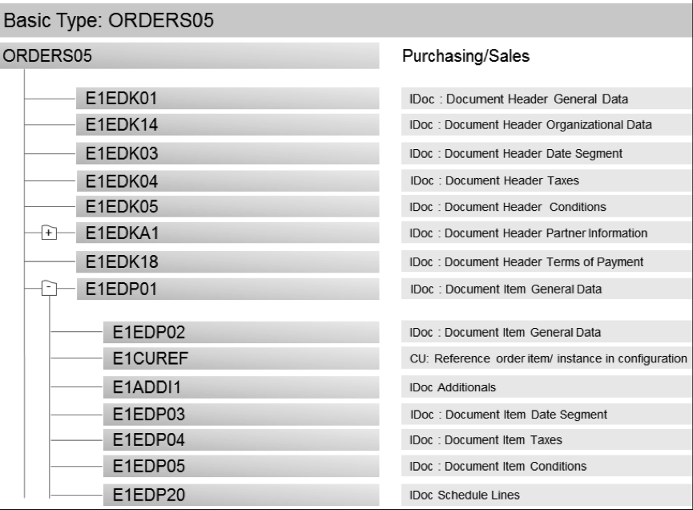
IDOC
IDoc Types are based on the EDI standards and mostly on EDIFACT standards.
Basic Types (or IDoc Type) defines the structure of an IDoc. Each basic type describes standard IDoc segments,

Slide 15
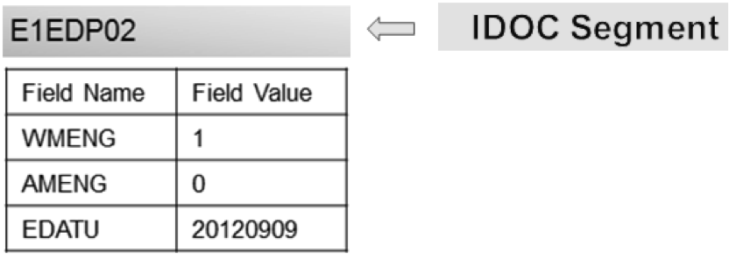
IDOC
IDOC SEGMENTS
IDoc segments contain the actual data that is sent to or received from a partner. These segments contain the actual values that are sent as part of IDoc transmission.

Slide 16
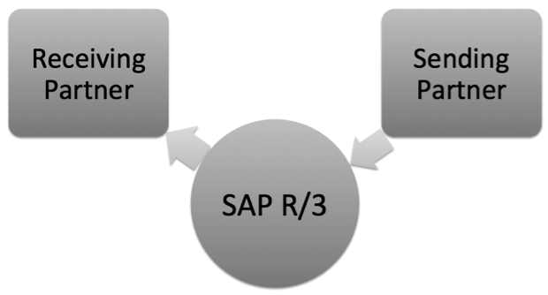
PARTNER: Partner is the Business Partner with which the exchange of information is to take place using IDoc. It can be a vendor or customer or any other system.

Slide 17
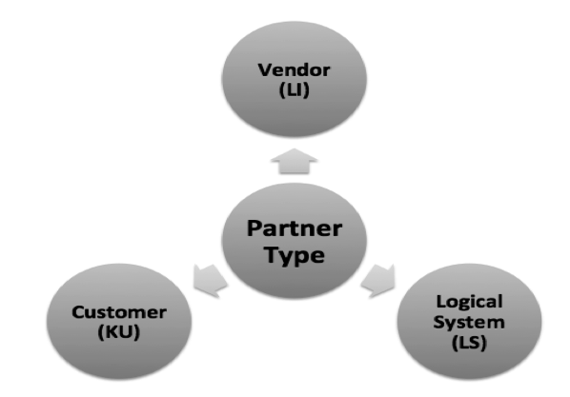
IDOC
PARTNER TYPE
Partner type/role is used to identify partners within the sap systems. Partner type is KU for customer, LI for vendor and LS for Logical System.

Slide 18
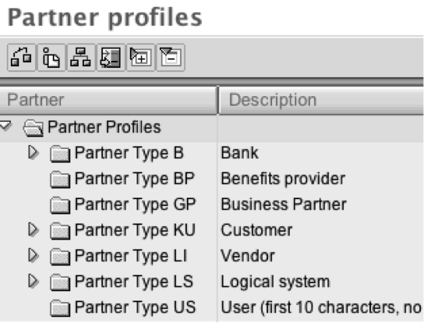
IDOC
PORT
IDoc Port contains the information about the way data is sent between the source or target system
PARTNER PROFILE (WE20)
Partner profile must be maintained for all the business partners to whom we want to send or receive the IDocs. The TCODE for maintaining the partner profile is WE20

Slide 19
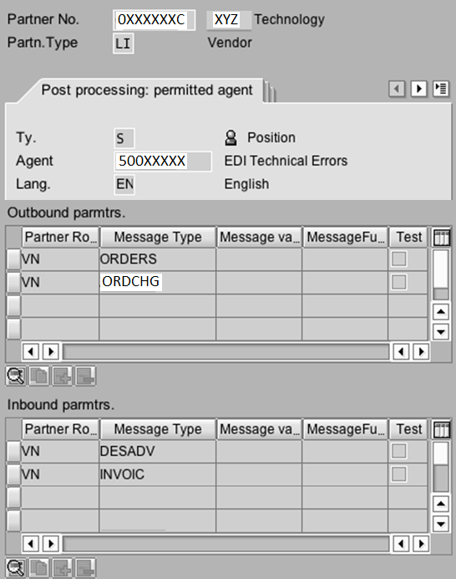
IDOC
Double clicking on the Partner will show the following screen:

Slide 20
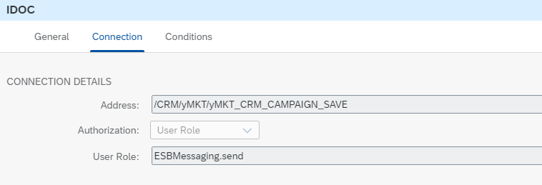
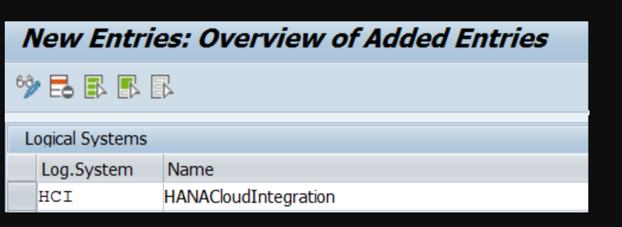
IDOC Adapter
Deploy iflow for idoc adapter
Define logical system in ECC

Slide 21
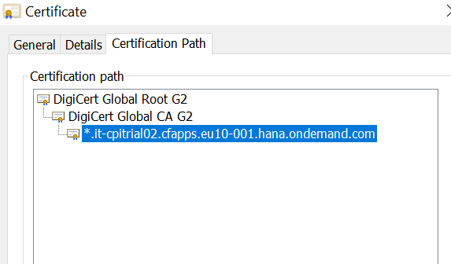
Go to your HCI URL, View Certificate ( from padlock ) –> Details –> Copy to File –> Select Default Options
In ECC go to transaction STRUST
Go to view – SSL Client SSL Client ( Anonymous )
Import your HCI SSL Certificate here.
Click on Import Certificate
Select your certificate from previous step
Click on Add to Certificate List

Slide 22
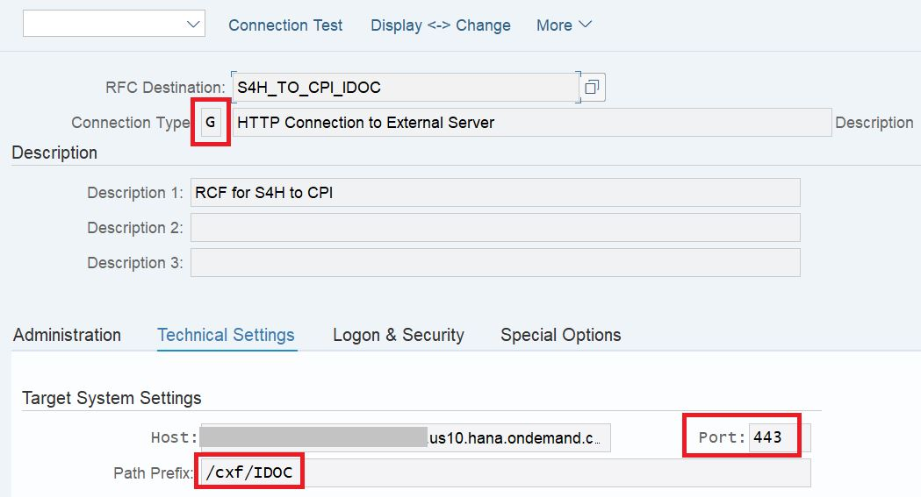
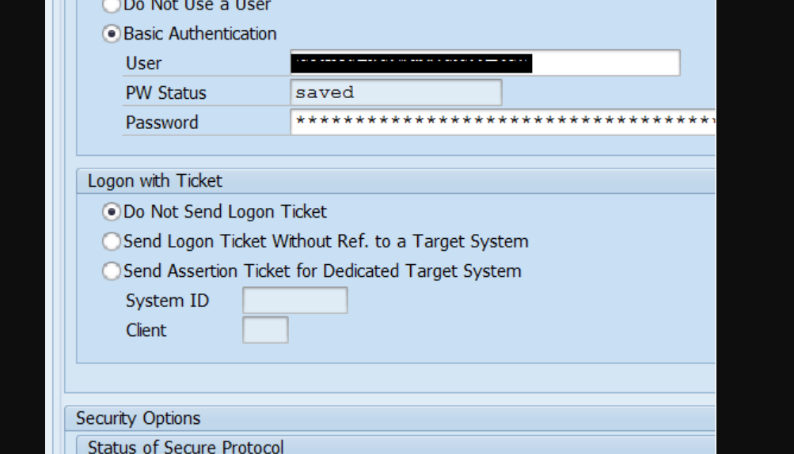
IDOC ADPATER
GOto SM59
Create connection type G
Target Host: <HostName from the Endpoint URL copied from HCI>
Service No: 443
Path Prefix : /cxf/<Path in Address Field of IDoc Adapter>
Under logon and security :
Basic Authentication – Provide your HCI User & Password
Security Options,
SSL – Active
SSL Certificate – Anonym SSL Client ( Anonymous ) – The view where the HCI SSL Certificate was loaded in previous steps in STRUST

Slide 23
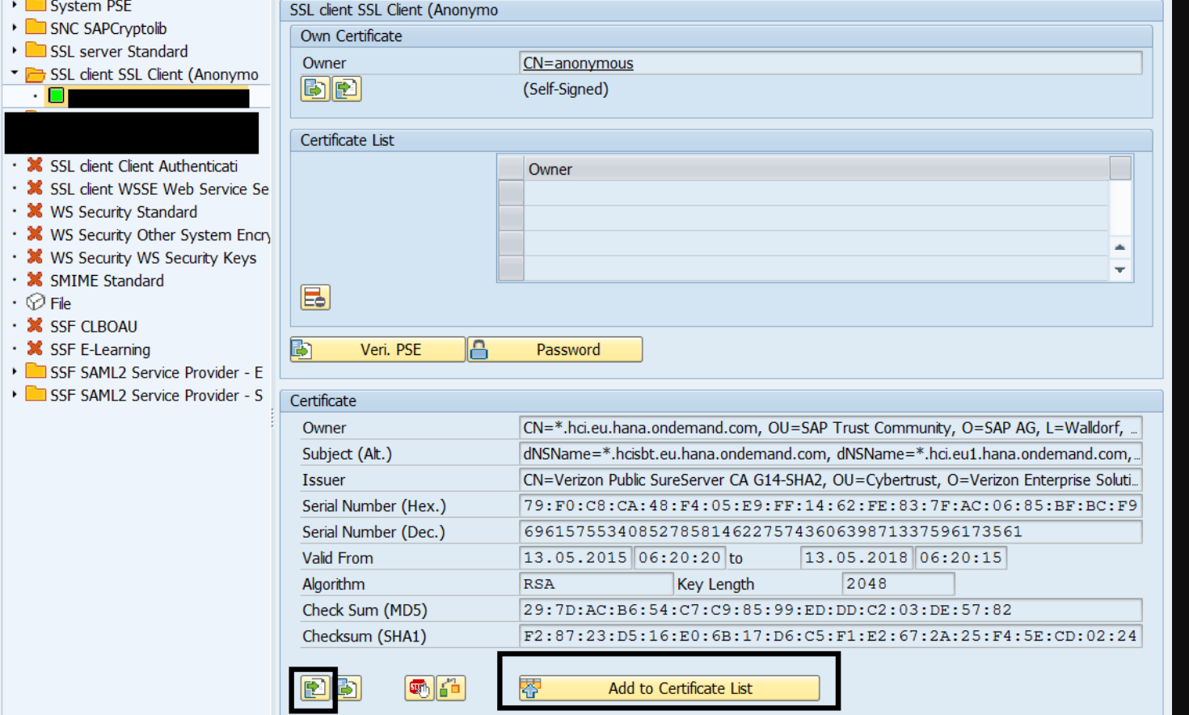

Slide 25
Goto Transaction we21
create a XML HTTP Port
Port Type : XML HTTP
RFC Destination : HTTP Destination Type G from Previous Step
Content Type – Default Setting – Text/XML
SOAP Protocol – Selected
As HCI is expecting the IDoc as a SOAP over HTTP, do ensure that SOAP Protocol is selected here. This will make sure that the message that goes out from ERP is a SOAP message

Slide 26
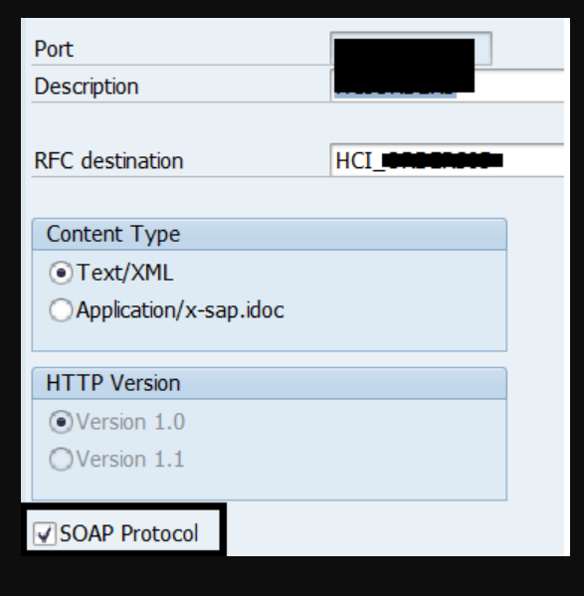

Slide 27
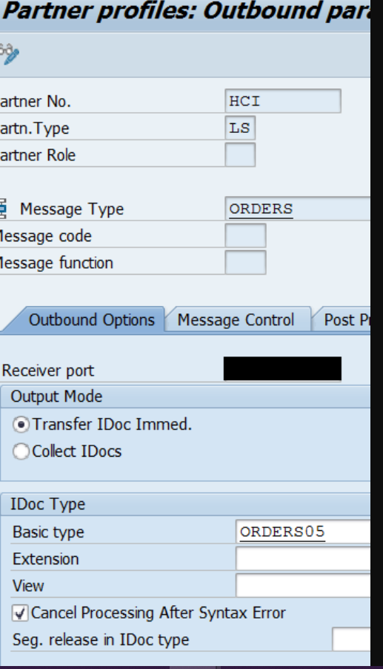
Transaction : WE20
Add an outbound entry for your Logical System
as per the IDoc being used.
For eg we are using ORDERS.ORDERS05 IDoc and
hence the outbound entry will contain the ORDERS.ORDERS05
details
The Port will be the port created in Previous Step.

Slide 28
https://blogs.sap.com/2020/07/15/sap-s4h-idoc-to-sap-cpi-inbound-idoc-interface/

Slide 29
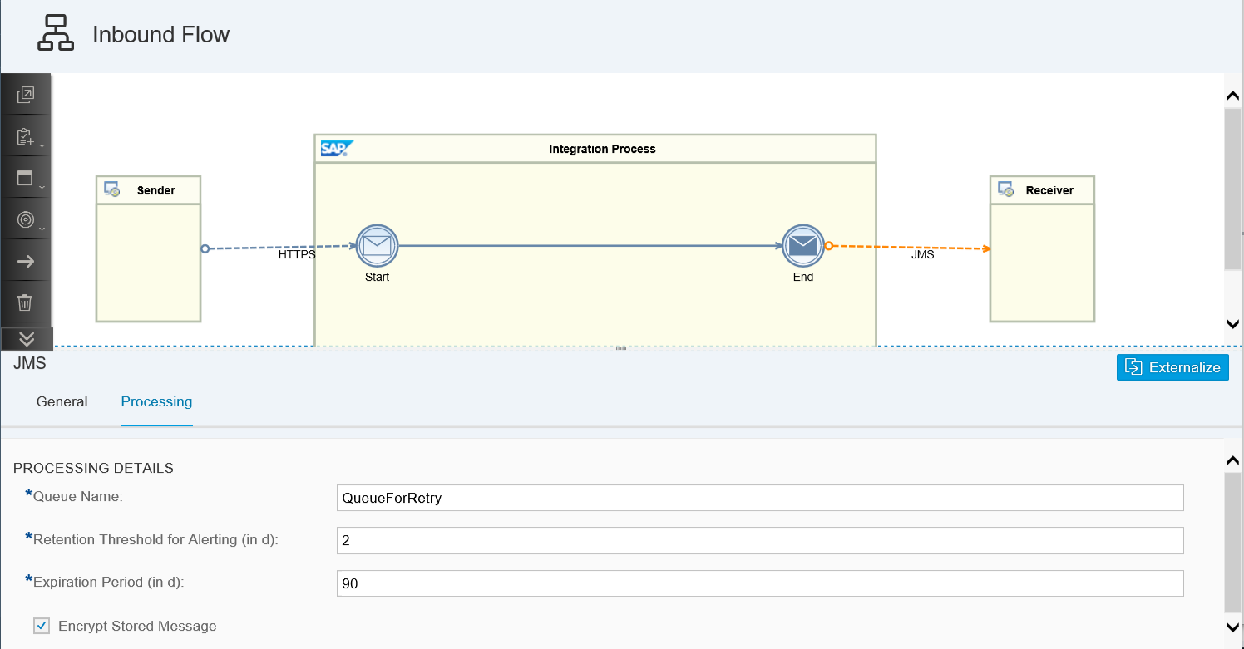
JMS

Slide 30
JMS
Configure the JMS Sender Channel
Create the integration flow with the outbound channel required by your scenario, and use the JMS adapter as the inbound adapter. You only have to configure the Queue Name for the JMS queue that you want to poll the messages from. Use the same queue name used in the receiving integration flow.
Number of Concurrent Processes is set to 1 per default and should only be increased if more parallel processing is needed. Because the JMS resources are limited, you need to keep the number of parallel processes as low as possible. Especially if large messages are processed in the scenario, increasing the parallelism may lead to out of memory problems.

Slide 31
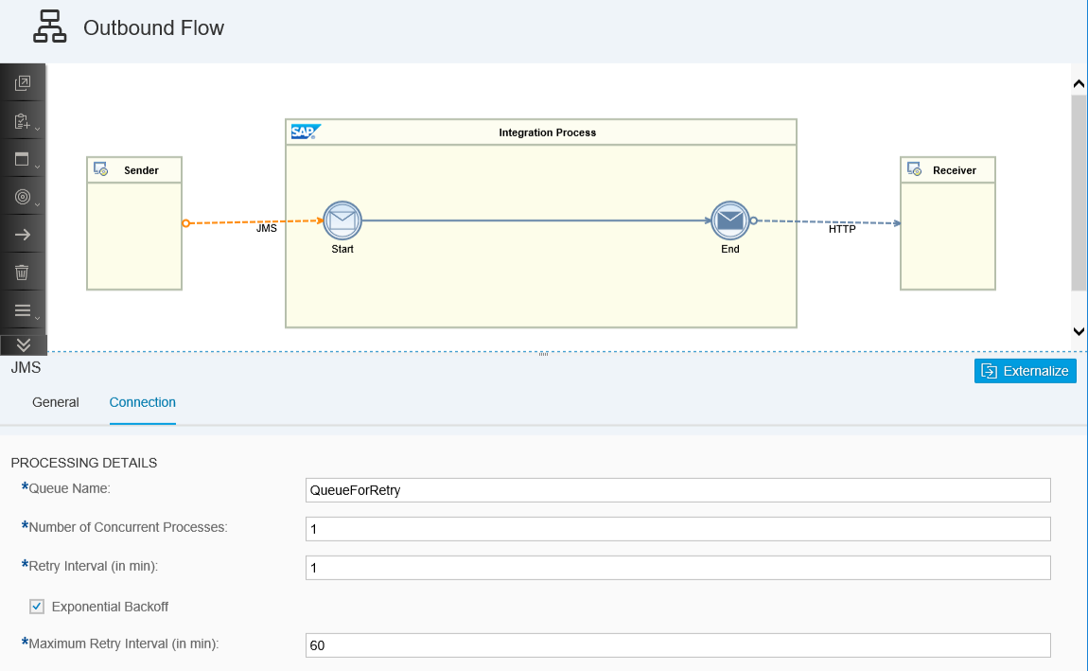
JMS
JMS Sender Adapter

Slide 32
JMS
Resource Limits for SAP Integration Suite Standard Edition:
Maximum number of queues: 30
Total queue capacity: 9.3 GB
Maximum capacity for one queue: 95% of the total queue capacity
150 transactions
150 consumers
150 providers
150 GB of data per month can be processed by JMS messaging
256 messages can be processed in one transaction

Slide 33
SFTP Adapter
Use SFTP adapter to encrypt and exchange sensitive business data between trading partners.
The SFTP Adapter connects an SAP Cloud Integration tenant to a remote system using the SSH File Transfer protocol to write files to the system.The SFTP adapter uses a certificate and keystore to authenticate the file transfer unlike the standard FTP. The SFTP adapter achieves secure transfer by encrypting sensitive information before transmitting it on the network. It uses SSH protocol to transfer files.

Slide 34
How SFTP Works
A tenant can connect as SFTP client to an SFTP server (the latter either hosted at SAP or in the customer landscape).
Depending on the direction of data flow (whether the tenant reads data from the SFTP server or writes data to it), either an SFTP sender adapter or SFTP receiver adapter is involved.
Files are stored on the SFTP server in specific directories referred to as mailboxes. For each mailbox, a user is specified in order to control access to the data.
In certain cases, you have the option to choose between the following authentication options for SFTP connectivity in the SFTP (sender or receiver) adapter:
User Name/Password
Public Key

Slide 36
Configuring the SFTP Client (Tenant)
In certain cases, you have the option to choose between the following authentication options for SFTP connectivity in the SFTP adapter:
User Name / Password
Public Key
If you have selected Public Key, perform the following steps:
Create a known hosts file and enter the required data (SFTP server host name, public key algorithm, and public key).
Generate an SFTP key pair and import it into the tenant keystore.
Deploy the keystore and the known hosts file as artifacts on the tenant.
If you have selected User Name / Password, perform the following steps:
Create a User Credentials artifact containing the credentials to be used when the SFTP client connects to the SFTP server.
Deploy the artifact on the tenant using the Web UI (Monitoring application).

Slide 37
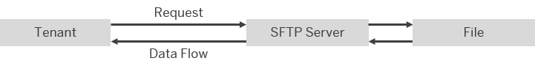
SFTP Sender Adapter
The SFTP sender adapter connects an SAP Cloud Integration tenant to a remote system using the SSH File Transfer protocol to read files from the system. SSH File Transfer protocol is also referred to as Secure File Transfer protocol (or SFTP).
If you have configured a sender SFTP adapter, message processing is performed as follows at runtime: The tenant sends a request to an SFTP server (think of this as the sender system), but the data flow is in the opposite direction, from the SFTP server to the tenant. In other words, the tenant reads files from the SFTP server (a process that is also referred to as polling).

Slide 38
SFTP Sender (Source)
Parameters | Description
Directory | Relative path to read the file from a directory. Example: parentdirectory/childdirectory
File Name | Name of the file to be read
Address | Host name or IP address of the SFTP server and an optional port, for example, wdfd00213123:22.
Proxy Type | Internet or On premise
Authentication | Basic,Credentails,Public key,Dual
Timeout (in ms) | Maximum time (in milliseconds) to wait for the SFTP server to be contacted while establishing a connection or performing a read operation
Maximum Reconnect Attempts | Maximum number of attempts allowed to reconnect to the SFTP server before message processing starts

Slide 39
SFTP adapter(processing)
Read Lock Strategy:Prevents files that are in the process of being written from being read from the SFTP server.
None (default): Does not use a read lock, which means that the endpoint can immediately read the file.
Content Change: Monitors changes in the file length/modification timestamp to determine if the write operation on the file is complete and the file is ready to be read
Done File Expected : Uses a specific file to signal that the file to be processed is ready for consumption.
Max. Messages per Poll:Maximum number of messages to gather in each poll. Consider how long it will take to process this number of messages, and make sure that you set a higher value for Lock Timeout (in min). The messages are picked up sequentially.

Slide 40
SFTP Receiver adapter
The SFTP receiver adapter connects an SAP Cloud Integration tenant to a remote system using the SSH File Transfer protocol to write files to the system. SSH File Transfer protocol is also referred to as Secure File Transfer protocol (or SFTP).

Slide 41
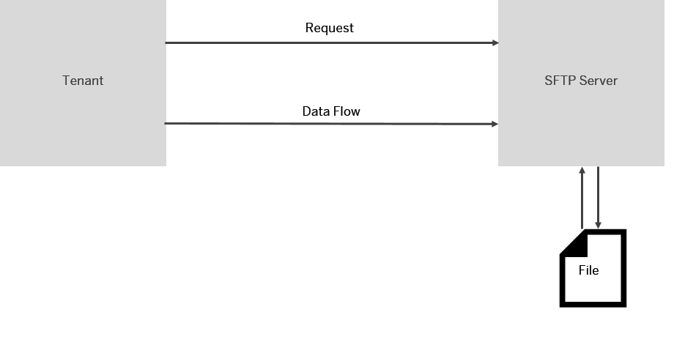
How the Receiver SFTP Adapter Works
If you have configured a receiver SFTP adapter, message processing is performed as follows at runtime: The tenant sends a request to an SFTP server (think of this as the receiver system), and the data flow is in the same direction, from the tenant to the SFTP server. In other words, the tenant writes files to the SFTP server (from where the communication partner can read them).

Slide 42
SFTP Receiver Adapter: Tenant writes file to SFTP server
Parameters:
Directory-Use the relative path to write the file to a directory.
Filename-Name of the file to be written.
Append Timestamp-Appends a timestamp at the end of the file name.
Address-Host name or IP address of the SFTP server and an optional port, for example, my.host.org:22.
Location ID-To connect to an SAP Cloud Connector instance associated with your account, enter the location ID that you defined for this instance in the destination configuration on the cloud side.
Authentication-Authentication option for the connection to the SFTP server.
Credential Name-Name of the User Credential artifact that contains the user name and password.

Slide 43
Create Directories-If selected, creates missing directory levels as provided in the file's pathname (selected by default).
Flatten File Names-Flatten the file path by removing the directory levels so that only the file names are considered and they are written under a single directory.
Handling for Existing Files-
Append: Adds the new file content to the end of the existing one.
Fail: System raises a failure (without any further action).
Ignore: System does not execute any further action.
Override: Replaces existing file content with the new one.
Use Temporary File-If selected, files are stored temporarily with a temporary file name before being converted to the target file name (as specified in the adapter).
Even with a timestamp appended to the file name, there is a chance that files are overwritten accidentally when a large number of files is created in a short time period (nearly at the same time). Using temporary files with unique file names is an option to prevent the system from overwriting files.
Temporary File Name-Enter a unique temporary file name.

Slide 44
To connect with SFTP sever we have 2 option
CPI to SFTP via Cloud connector
CPI to SFTP via internet.
If you are connecting via cloud connector, we need whitelist cloud connector IP. In case without cloud connector we need whitelist the CPI tenant Public IP range.
If you are connecting via cloud connector adapter we need to provide location ID and proxy should be On-premise

Slide 45
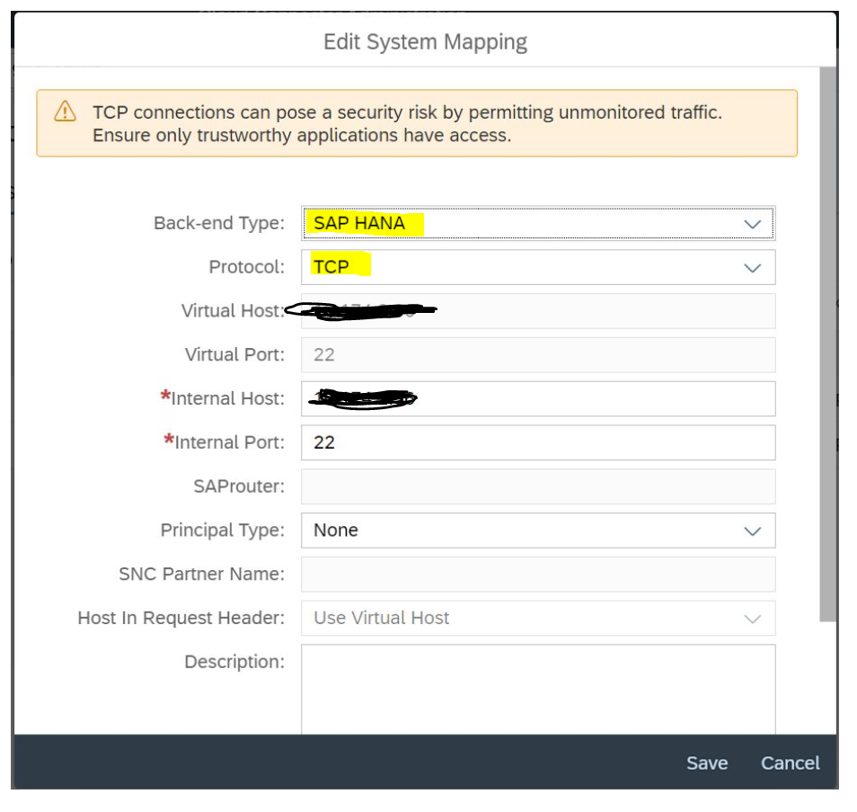
SFTP
Cloud Connector Configuration
Here backend system SAP HANA system to access AL11
Back end type: SAP HANA
Protocol: TCP
Virtual host: any dummy ip address which same need to use at CPI and Cloud connector
Virtual port: 22
Internal host: sftp sever IP
Internal port: 22

Slide 46
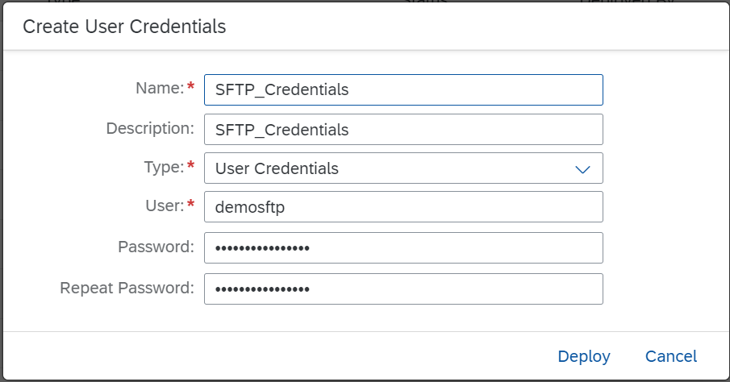
SFTP
Below are the steps, how to add SFTP and FTP Credentials:
Monitoring —>Manage Security —> Security Material —> Add —> User credentials
>Name: SFTP_Credentials (Same name you need to use in the SFTP adapter)
>Type: User Credentials
>User and Password
Click on Deploy

Slide 47
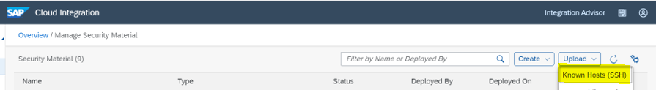
Twitter Adapter
SFTP Connection test :
Monitoring —> Manage Security —> Connectivity Tests, Select SSH for SFTP server connection.
SFTP Host Key file upload:
Monitoring —>Manage Security —> Security Material —>upload
Copy host key file upload at shown below.

Slide 48
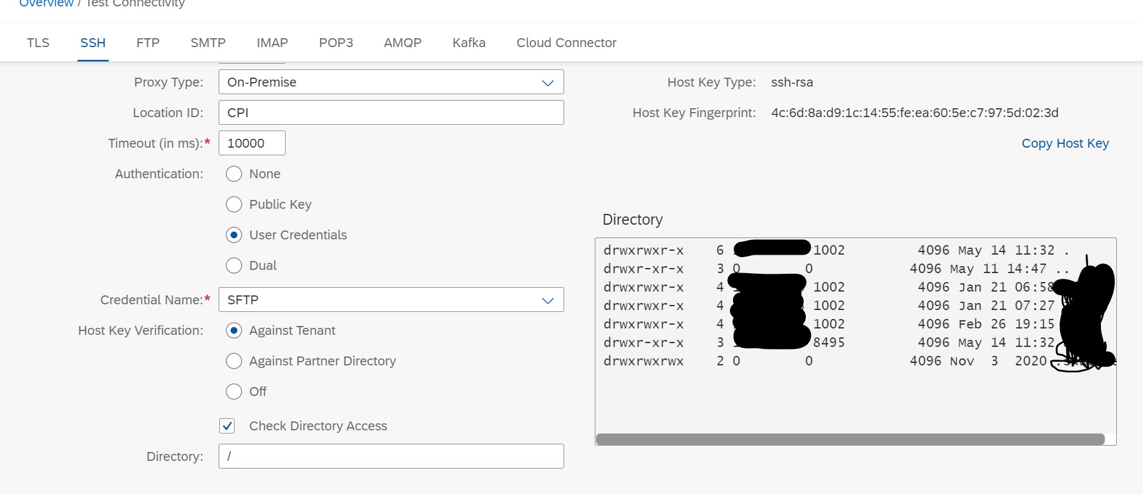
To check directory folder access and folder permission.
At directory level provide /

Slide 49
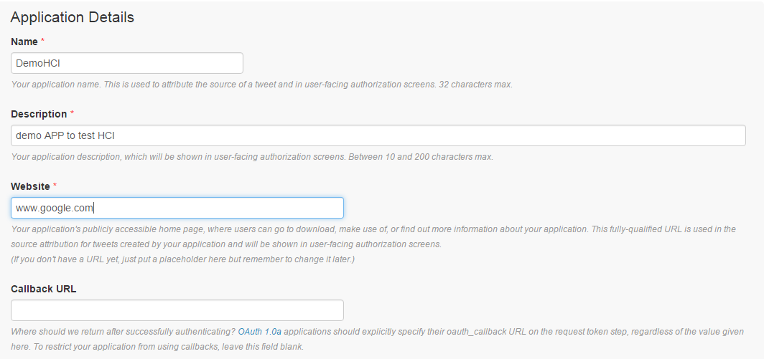
Twitter Adapter
Twitter Configuration:
The configuration in twitter involves generation of tokens and secret keys to enable authentication to the twitter application. We need to follow an app-based approach to get the required keys. The steps are as follows.
Log into https://developer.twitter.com/enusing the twitter credentials.Scroll down to the bottom and select “Manage Your Apps” under TOOLS category.
On the next screen select “Create a new app”.

Slide 50
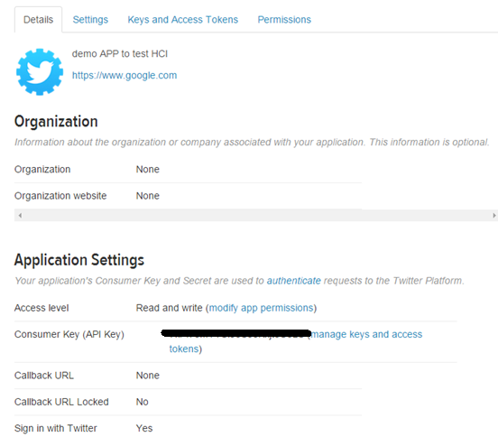
Filled the Website parameter, just because it was mandatory, and since it is a demo app.
Select “Create Twitter Application” once you have filled the basic details. The next screen would look like this.

Slide 51
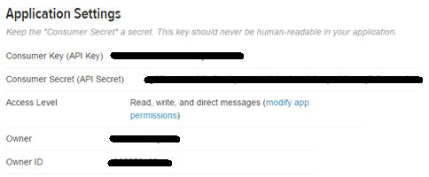
Click “modify app permissions” to select the permission level based on the activity you want to perform.
Click on manage keys and access tokens. Note down the Consumer Key, and Consumer secret.

Slide 52
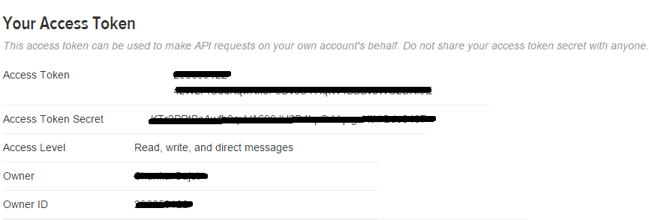
Scroll down to get your Access token and Access secret.

Slide 53
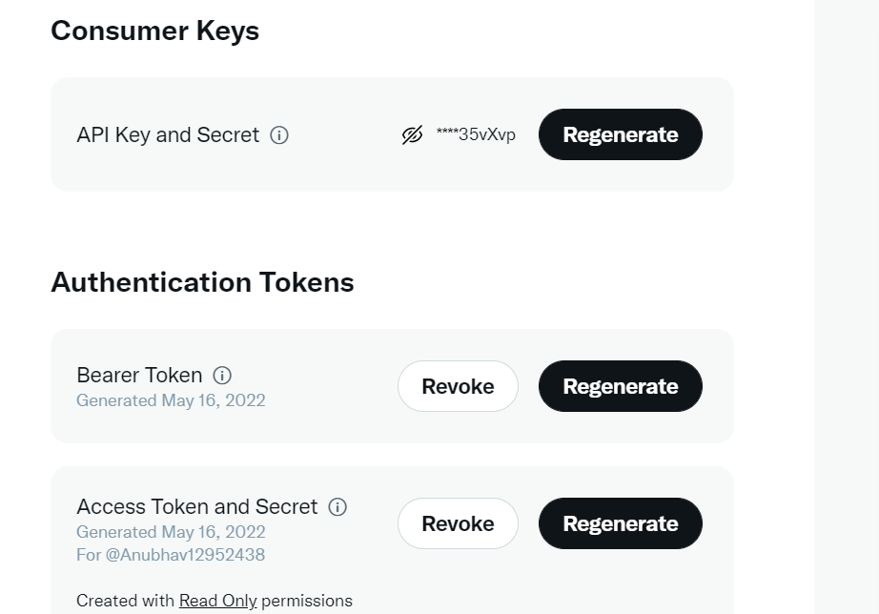

Slide 54
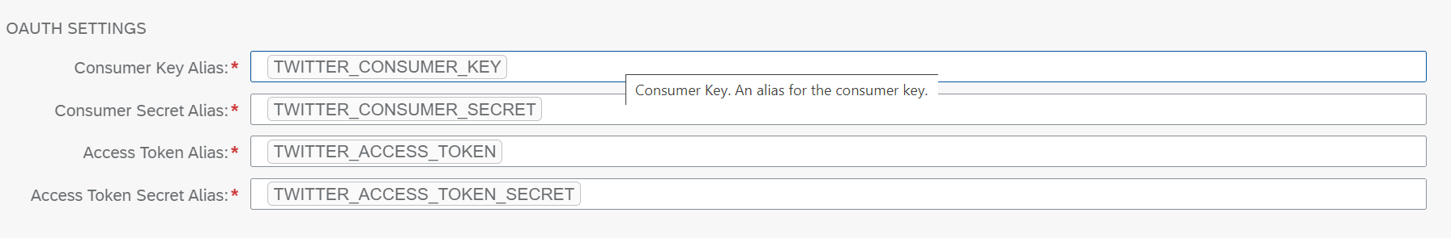

Slide 55
These are the four parameters that are essentially needed to authenticate to Twitter, and that are required to configure the Receiver Communication Channel. So the next step would be deploying these parameters in HCI as “Secured Parameters”.

Slide 56
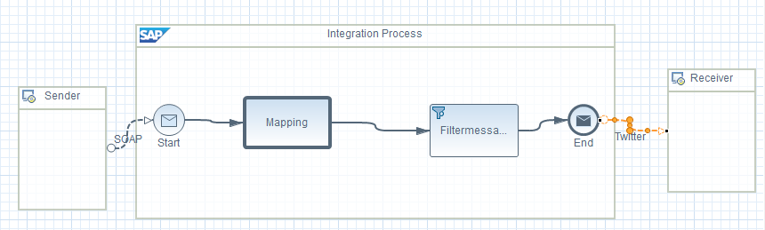
TwiTter Adapter

Slide 57
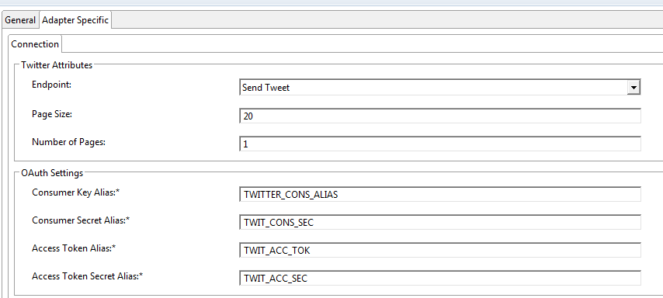
Configure the receiver channel as follows. Select the “Send Tweet” endpoint post a tweet. Type in the corresponding artifact names that were deployed earlier.

Slide 58
For sending DM to other profiles, select the endpoint as “Direct Message” in the receiver comm.channel and enter the twitter ID of recipient(without the’@’). Rest all procedures, remain the same.
Send Tweet – Allows you to send content to a specific user timeline.
Search – Allows you to do a search on Twitter content by specifying keywords under filter settings.
Send direct message – Allows you to send messages to Twitter (write access, direct message).
Page size – specifies the maximum number of tweets per page

Slide 59
Ariba Adapter

Slide 60
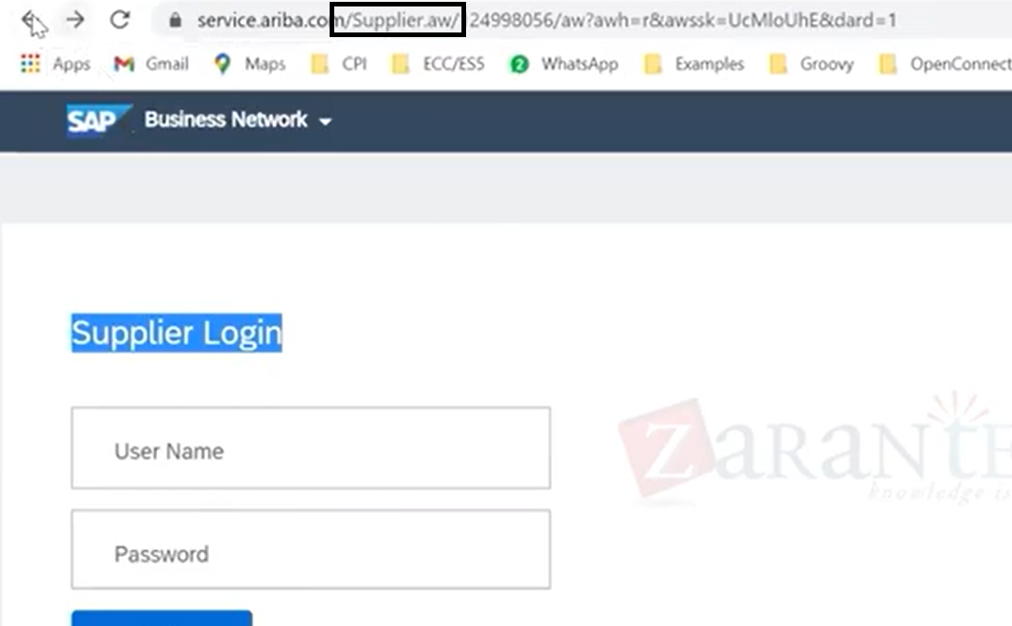
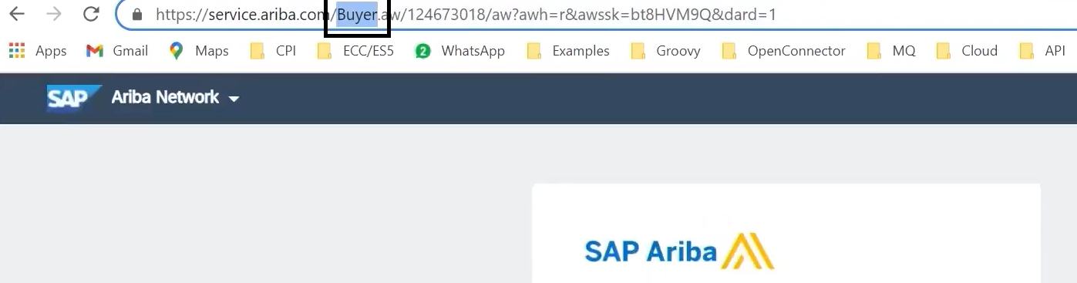
Ariba

Slide 61
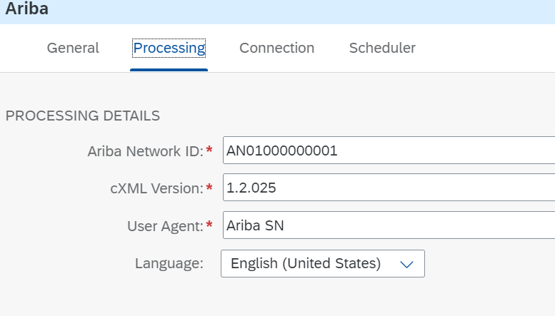
Test and Prod system

Slide 62
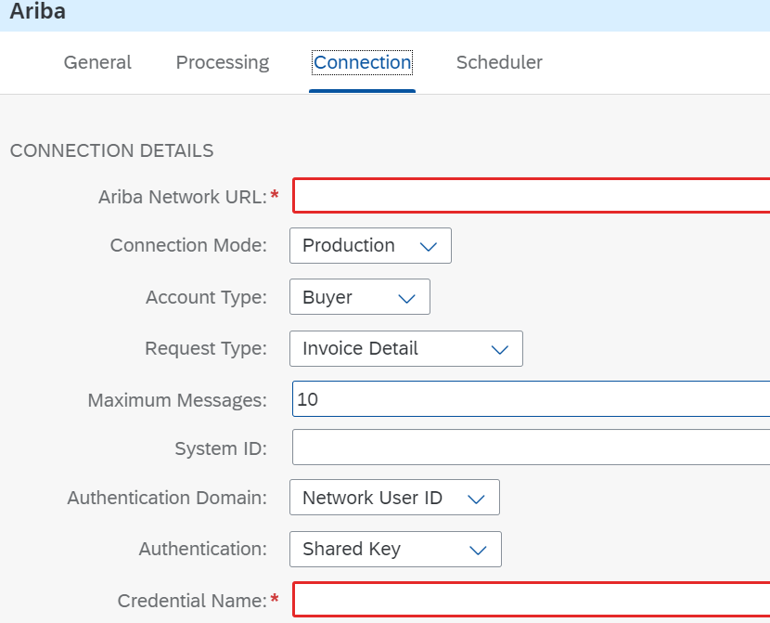

Slide 63
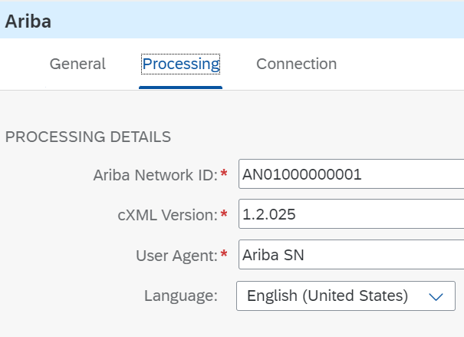
Ariba Receiver Adapetr

Slide 64
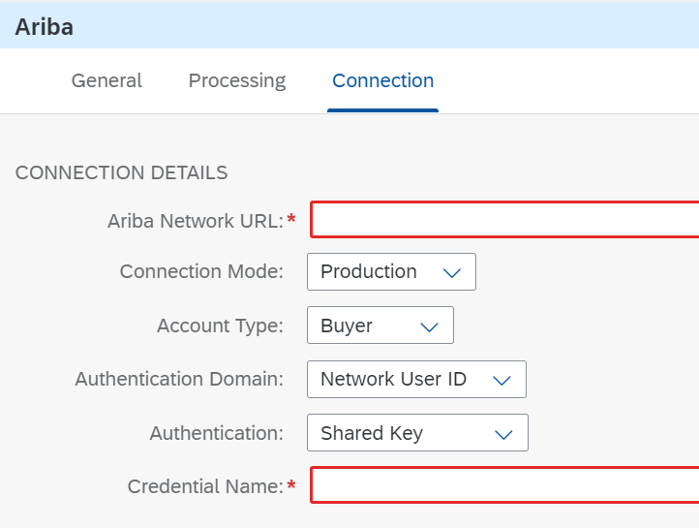

Slide 65
Success factor Adapter
Deploying the Credentials using which you would connect to the SuccessFactors system

Slide 66
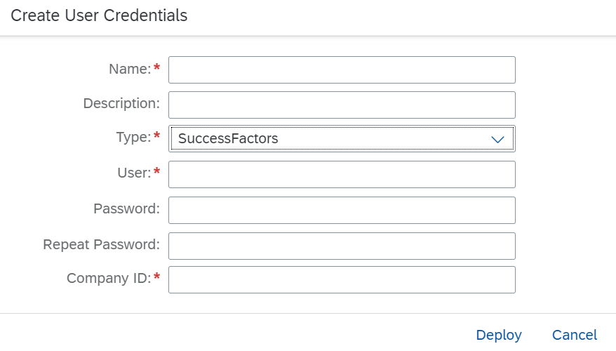

Slide 67
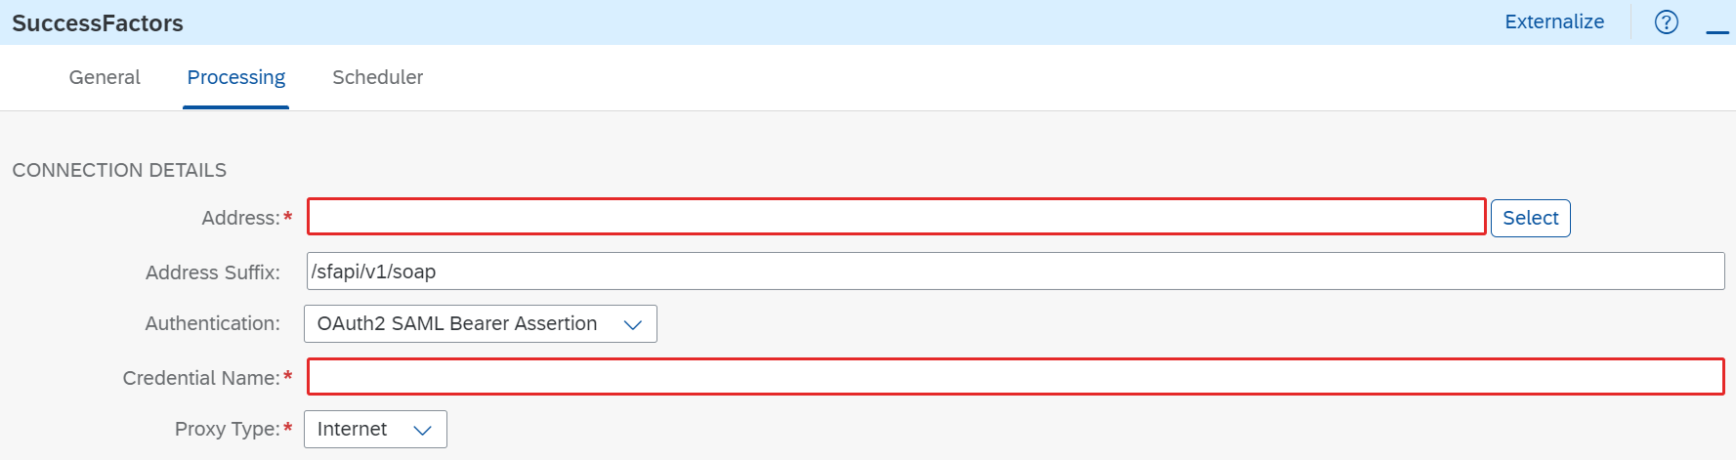
Sender Successfactor Adapter

Slide 68
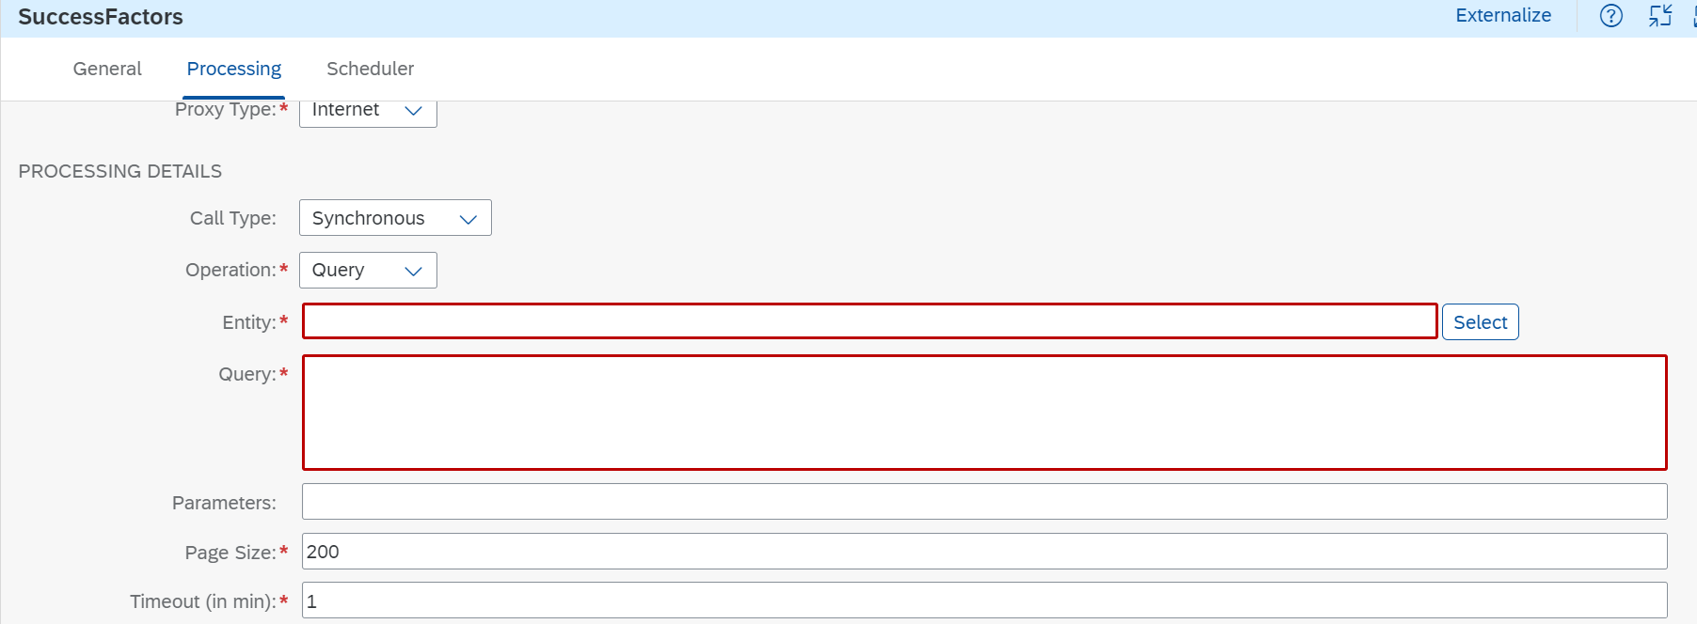

Slide 69
Parameter | Description
Address | URL of the SuccessFactors data center that you want to connect to. You can browse and select the SuccessFactors data center URL by using the Select option.
Authentication | Select one of the following authentication methods:Basic OAuth2 SAML Bearer Assertion
Credential Name | Credential name for your credentials that has been deployed on the tenant.
Call Type | Synchronous and ASynchronous
Operation | GET
Entity | Entity that you want to access in the SuccessFactors system
Query | Provide your query values to look out for the relevant table or field in the SuccessFactors system.

Slide 70
Page Size | Maximum number of records to be fetched in a page of response.
Timeout (in min) | Maximum time the system waits for a response.

Slide 71
Groovy Script
Groovy is developed with following libraries in-built inside so no need to import them once again. ref
import java.lang.*
import java.util.*
import java.io.*
import java.net.*
import groovy.lang.*
import groovy.util.*
import java.math.BigInteger
import java.math.BigDecimal

Slide 72
Groovy in CPI is pre-designed with static void main(String[] args) function, so no need to write it again, else it might give errors

Slide 73
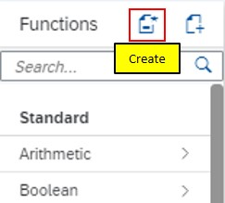
Steps to create a UDF in CPI –
Create required flow with a message mapping in it.
Assign your desired Source and Target structures
click the create icon in Functions section.

Slide 74
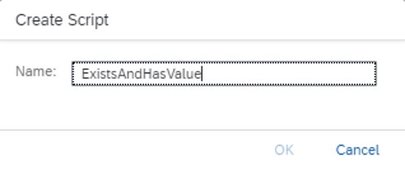
The icon next to create is for assigning/importing an already created UDF. A groovy code can be copy pasted in notepad, and can be saved with extension name.groovy, which can later be imported here in mapping for use.
Give some name to your script, and click ok

Slide 75
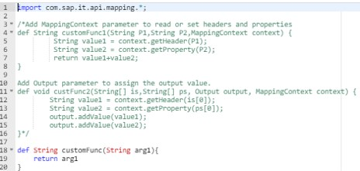
This creates a sample script with a default code as shown below.

Slide 76

The customFunc code mentioned by default, basically passes the input value to the output as it is, without any processing.
rename the customFunc as per your script name for now to avoid confusion, will talk about the added functionalities in later part.

Slide 77

Steps to assign an already created script
This would be useful hereafter, to use code in a notepad, save with name.groovy extension and import in mapping.
click on assign icon, and below window opens. Select the “Upload from File System”, and choose the groovy file to upload.

Slide 78

Alternate Way
go to home page of integration flow -> go to resource tab -> Add -> Script -> Select File System -> Browse & Upload

Slide 79
Test Groovy script
https://groovyide.com/cpi

Slide 80
To record logs so that you can capture the payload even if the IFlow is not on trace.
import com.sap.gateway.ip.core.customdev.util.Message;
import java.util.HashMap;
def Message processData(Message message)
{
def body = message.getBody(java.lang.String) as String;
def messageLog = messageLogFactory.getMessageLog(message);
if(messageLog != null)
{
messageLog.setStringProperty("log1","Printing Payload As Attachment")
messageLog.addAttachmentAsString("log1",body,"text/plain");
}
return message;
}

Slide 81

To record logs or capture the incoming payload, only if there is an exception.

Slide 82
import com.sap.gateway.ip.core.customdev.util.Message;
import java.util.HashMap;
def Message processData(Message message)
{
def map = message.getProperties();
def ex = map.get("CamelExceptionCaught");
if (ex != null)
{
exceptionText = ex.getMessage();
def messageLog = messageLogFactory.getMessageLog(message);
messageLog.addAttachmentAsString("Exception", exceptionText,"application/text");
}
return message;
}

Slide 83
Remove something from your payload, for example, “<?xml version=”1.0″ encoding=”UTF-8″?>“
import com.sap.gateway.ip.core.customdev.util.Message;
import java.util.HashMap;
def Message processData(Message message)
{
def removal=message.getBody(java.lang.String) as String;
removal=removal.replace(/<?xml version="1.0" encoding="UTF-8"?>/,"");
message.setBody(removal);
return message;
}

Slide 84
getProperties
import com.sap.gateway.ip.core.customdev.util.Message;
import java.util.HashMap;
import java.lang.*;
def Message processData(Message message)
{
map = message.getProperties();
return message;
}

Slide 85
Capture a property in the content modifier using XPATH, use single IF condition, create and update a new Property which can be used later in a Router or Mapping Expression maybe. In the example below, we are returning the result in a Property called, “Result”, which you could use in a router/ call it using ${property.Result} if required anywhere.

Slide 86
import com.sap.gateway.ip.core.customdev.util.Message;
import java.util.HashMap;
def Message processData(Message message) {
map = message.getProperties();
def zID = map.get("ID");
def indicator;
if(zID == '')
{
indicator = 'false';
}
else
{
indicator = 'true';
}
message.setProperty("Result", indicator);
return message;
}

Slide 87
concatenate a couple of fields.
import com.sap.gateway.ip.core.customdev.util.Message;
import java.util.HashMap;
import java.lang.*;
def Message processData(Message message)
{
map = message.getProperties();
def ZF1 = map.get("F1");
def ZF2 = map.get("F2");
def ZF3 = map.get("F3");
String ZConcat = ZF1.concat(ZF2).concat(ZF3);
message.setProperty("ConcatenatedResult",ZConcat);
return message;
}

Slide 88
Add days to a Date.
import com.sap.gateway.ip.core.customdev.util.Message;
import java.util.HashMap;
import java.lang.*;
import com.sap.it.api.mapping.*;
def Message processData(Message message)
{
Date zcurDate = new Date();
Date zNewDate = zcurDate + 30;
message.setProperty("Current_Date",zcurDate);
message.setProperty("New_Date",zNewDate);
return message;
}

Slide 89
Add days to a Date
import com.sap.gateway.ip.core.customdev.util.Message;
import java.util.HashMap;
import com.sap.it.api.mapping.*;
def String datePlus30(String header,MappingContext context){
Date zcurDate = new Date();
Date znewDate = zcurDate + 30;
return znewDate.format("yyyyMMdd");
}

Slide 90
Encoder and decoder

Slide 91

Summarize
LET’S SUMMARISE!

Slide 92

Summarize
End of Day 1

Slide 94


We’re committed to empower you to be
#FutureReady
through powerful training solutions.
We build the workforce of the future.
250+
Corporate Clients
30,000+
Learners Trained
25000+
Learners Placed
FREE WEBINARS
Sign up for free webinars with industry experts every fortnight!
Enroll Now!
Contact us today!
https://anubhavtrainings.com

